Slide 1
Chinches de Cama
Este programa de capacitación IPM (Manejo Integrado de Plagas) fue desarrollado por un consorcio que incluye al Instituto Nacional de Alimentación y Agricultura del Departamento de Agricultura de Estados Unidos, el Departamento de Vivienda y Desarrollo Urbano de Estados Unidos, la Agencia de Protección Ambiental de Estados Unidos, los Centros para el Control y Prevención de Enfermedades, el Programa IPM de Pennsylvania, la Asociación Nacional para el Manejo de Plagas, el Centro Nacional para la Vivienda Saludable y los Centros regionales de IPM.
Financiación por la EPA, HUD, los CDC y el USDA-NIFA.
Los materiales presentados a continuación están basados en investigaciones y un enfoque equilibrado y objetivo sobre el manejo de plagas en viviendas asequibles y están destinados a ser utilizados en su totalidad. No se recomienda cualquier uso no objetivo o parcial de los materiales. Los productos, proveedores, o servicios comerciales mencionados o ilustrados en las capacitaciones o presentaciones son sólo para fines ilustrativos sin pretender su endoso.
Notes:
Rev. 7-2014 Ver. 7/2014
This presentation focuses on bed bugs. It covers the biology, behavior, and what you should do up to the point where the PMP gets involved. From there, follow the pest control company's procedure.
Reference: For an evaluation of bed bug control options, see: http://www.nchh.org/Portals/0/Contents/bedbug_report.pdf

Slide 2

Temas a tratar
Que son
Que comen
Donde viven
Como pensar como un chinche de cama
Prevención y control
Conocidos también como…
Bed Bugs
mahogany flats
red coats
crimson ramblers
wall lice
Notes:
2
This is the outline for the presentation.

Slide 3
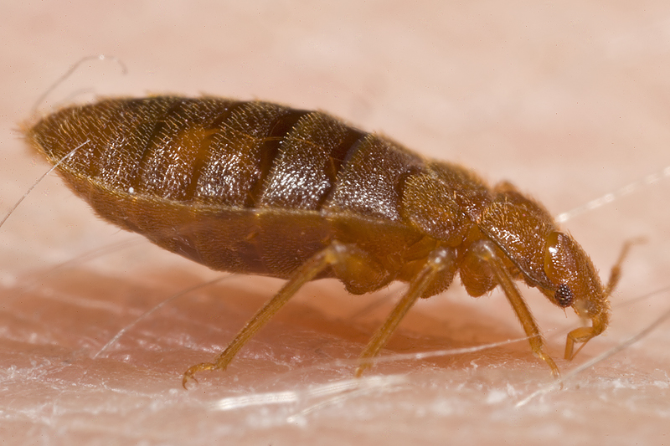
Qué es un chinche de cama?
Insectos planos, chupadores de sangre
Varían en tamaño de una semilla de sésamo a una semilla de manzana
De color marrón claro a rojo según cuando se alimentó por última vez
Chinche de cama adulto alimentándose en un humano

Slide 4
Por qué han regresado
Cambio en la disponibilidad de pesticidas
Cambio en los patrones de uso de pesticidas
Más viajes/movilidad de las personas
Más lugares infestados
Resistencia a pesticidas
Falta de preparación de la sociedad en general
Notes:
No one reason is to blame for the increase in bed bug infestations. They were never fully gone, but a bed bug treatment was uncommon for pest control companies. The rise has been referred to at "the perfect storm." Most likely it is a combination of all these factors that resulted in the situation we are dealing with today. Bed bugs are back, regardless of how they got here.

Slide 5
Las chinches de cama son un peligro para la salud
Las chinches no transmiten enfermedades, pero son una plaga de significante importancia para la salud pública
Causan infecciones secundarias después que las personas se rascan las picaduras
Resultan en estrés, pérdida de trabajo, pérdida de productividad, pérdida de sueño, y carga financiera
No son bienvenidos en nuestros hogares y lugares de trabajo
Notes:
5
Although bed bugs have not been shown to transmit disease, they do have an effect on physical and mental health. In 2010 EPA and CDC issued a joint statement, classifying bed bugs as a "pest of significant public health importance."
Physical effects could result from scratching the welts that show up on some people from the bed bug bite. The elderly and children may not have the self control to stop scratching and infection can result.
Many people with bed bugs cannot sleep and suffer negative effects. The stress from having bed bugs, having to treat them, and having to pay for it can take a significant toll.

Slide 6
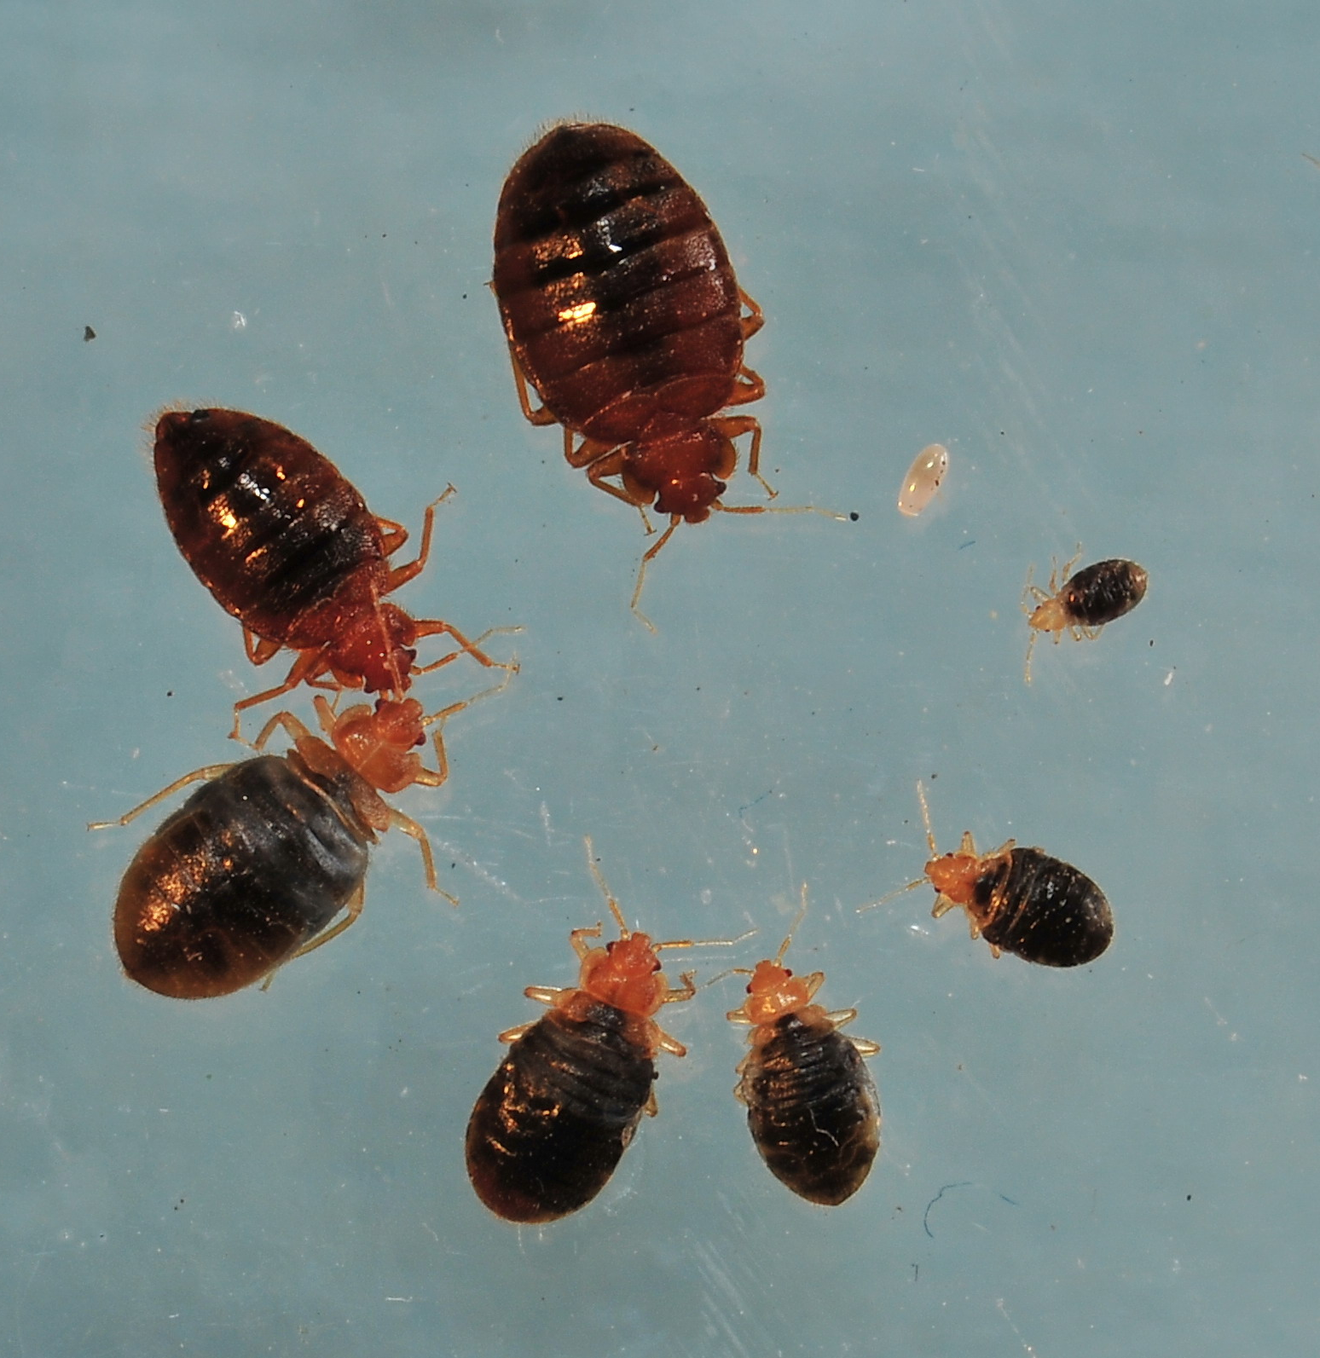
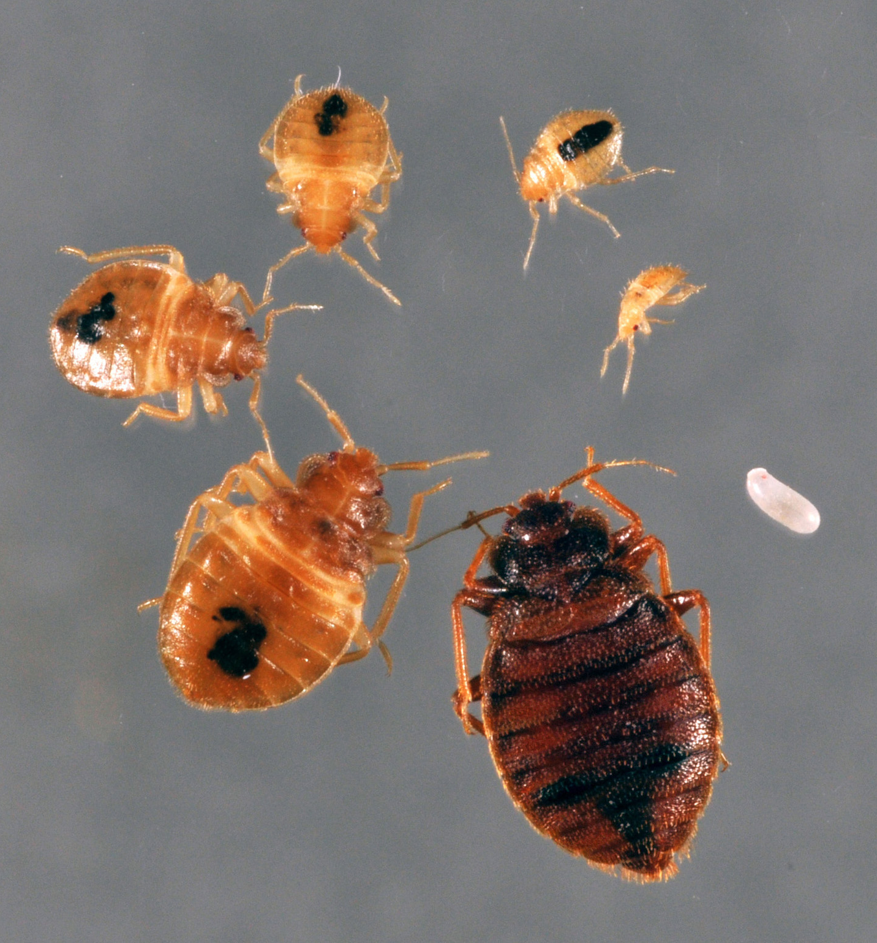
Ciclo de vida del chinche de cama
Alimentado
No alimentado
Notes:
Bed bugs can be two different shapes, depending on when they last fed. They expand when full of blood and quickly (within a few hours) digest the blood and poop out the excess so that they are flat again. A recently fed bed bug will be plump, but after it digests it is back to being flat.
Like cockroaches, baby bed bugs look like the adults, only smaller.

Slide 7
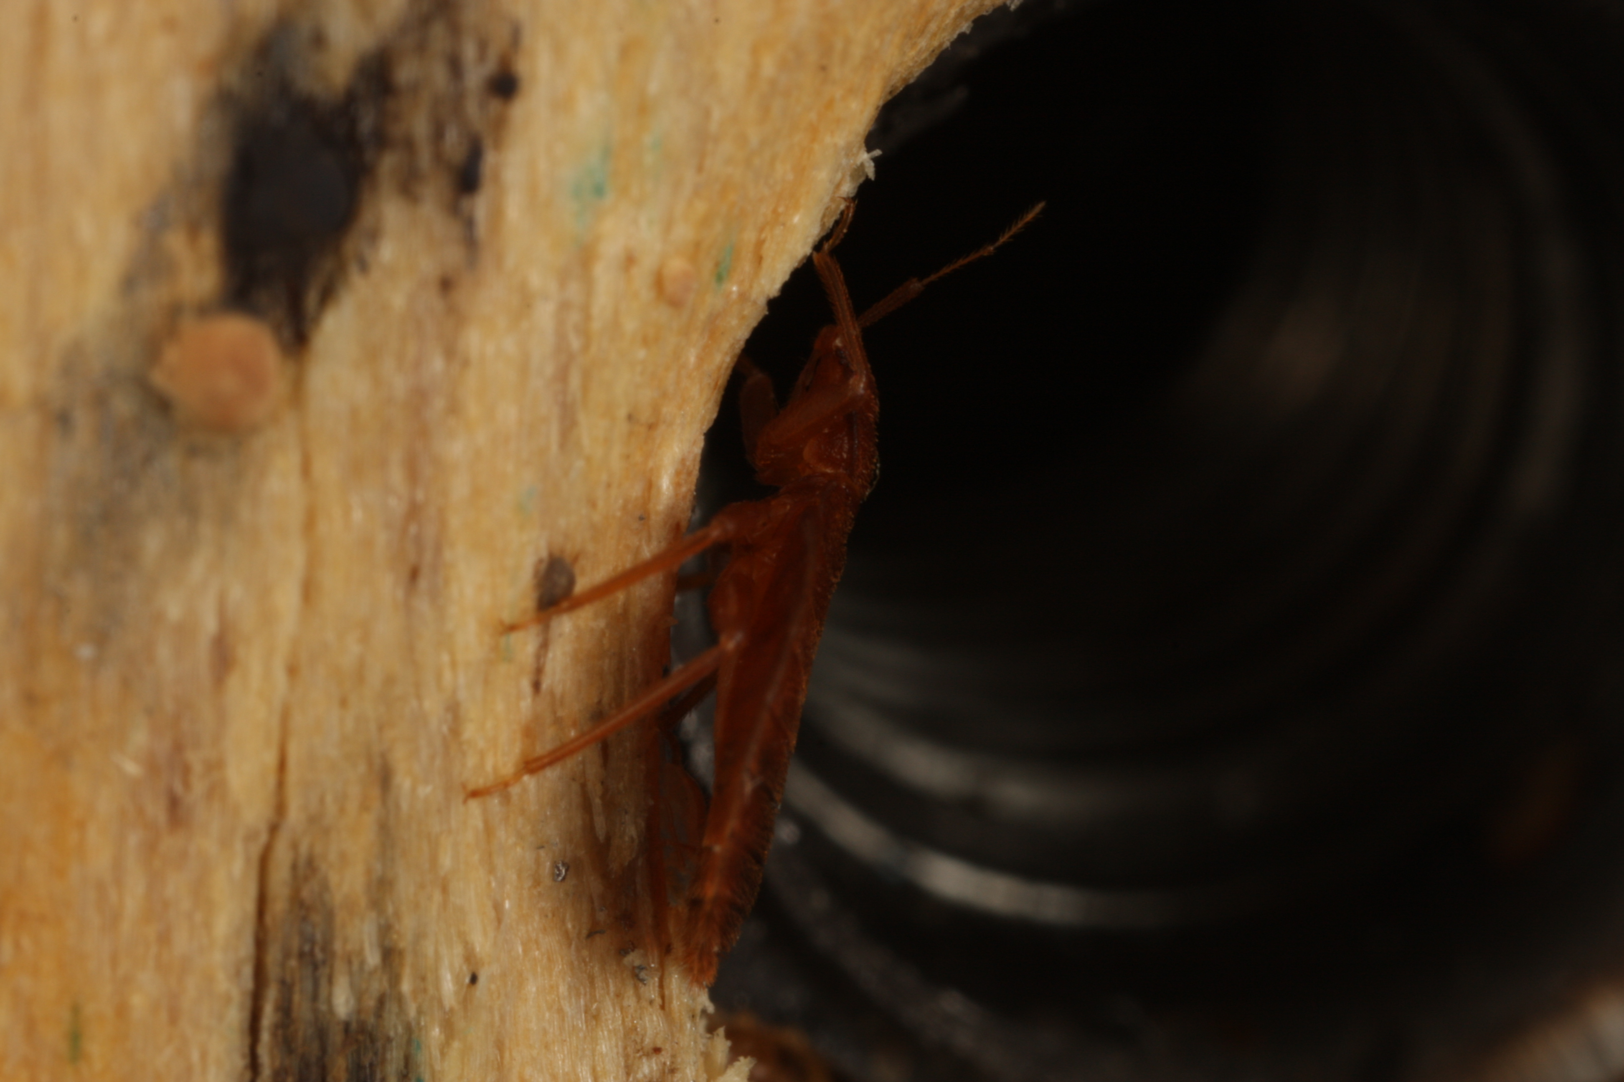
Comportamiento del chinche de cama
Activos sobretodo de noche
Se esconden en grietas y hendiduras, a menudo en grupos
No pueden volar, saltar, o enterrarse en la piel... caminan
Saben subirse y transportarse en abrigos, bolsos, muebles, sillas de ruedas…
Chinche arrastrándose a un agujero de tornillo para ocultarse
Notes:
7
Bed bugs will wedge into any crack that a credit card edge can fit into.
Although they are usually active at night, bed bugs will feed during the day if hungry. Most of the time, they are hiding in cracks and crevices near where they last fed. Usually where there is one, there will be more, but they are not dependent on each other, so “loners” can occur. Hiding spots can be in the furniture where people sleep (sofas, recliners, mattresses, box springs, and bed frames), the furniture next to the bed, lamps, alarm clocks, picture frames on the walls, baseboards, the edges of the carpets, electric outlets, and draperies.
They can get into other units and be carried home by staff members by hitchhiking on bags and used furniture (especially stuff that was picked up from trash) or by crawling into new units through walls.
Bed bugs will always be found crawling, never flying, jumping, or burrowing.

Slide 8
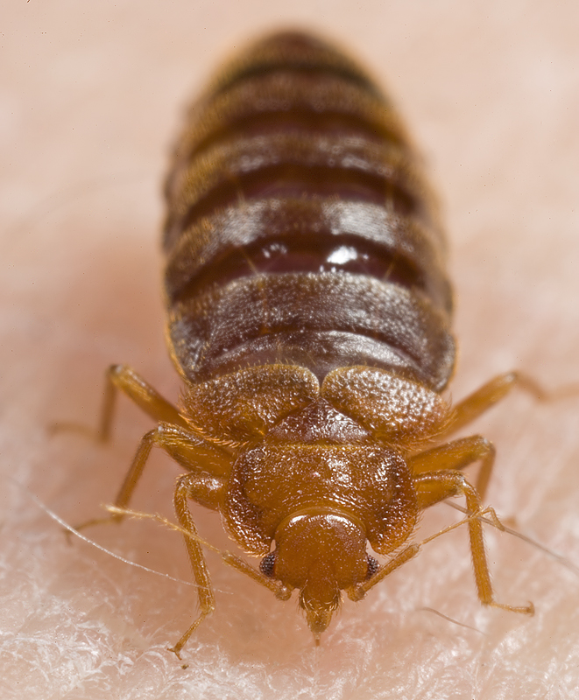
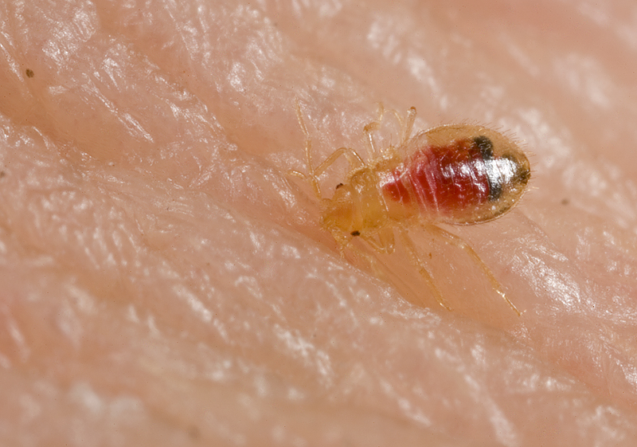
Lo que comen y toman las chinches de cama
Sangre
Notes:
8
Unlike cockroaches and rodents, bed bugs get both their food and water needs from blood. If there is a warm body, they can be happy. The baits intended for cockroaches and rodents will not work on bed bugs because bed bugs do not have chewing mouthparts to eat the bait. Also, boric acid (a stomach poison) will not work for bed bugs since they will not ingest it.

Slide 9
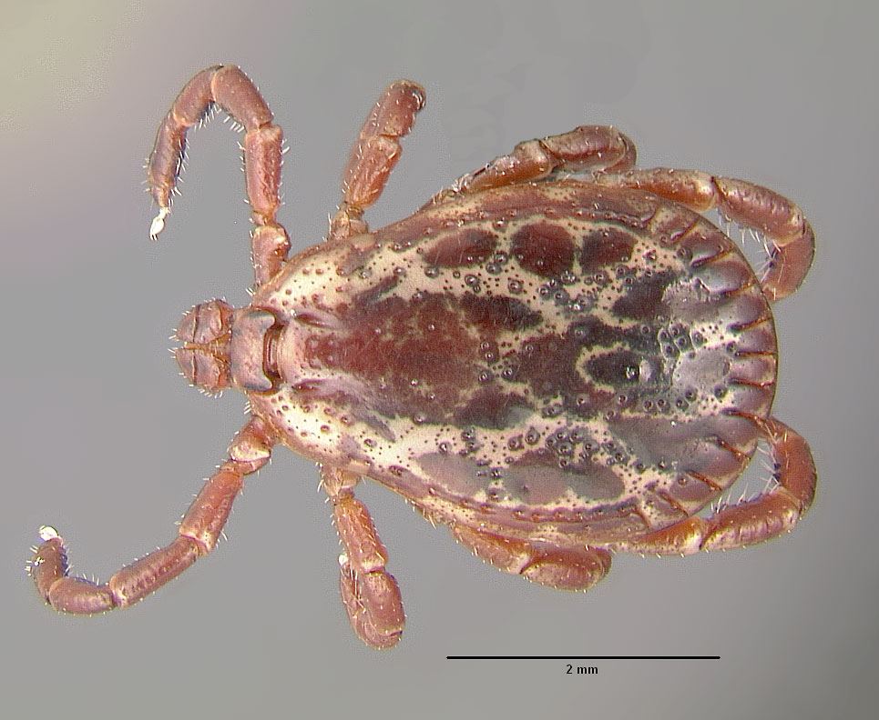
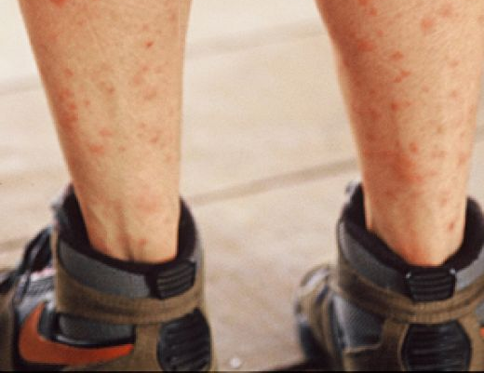
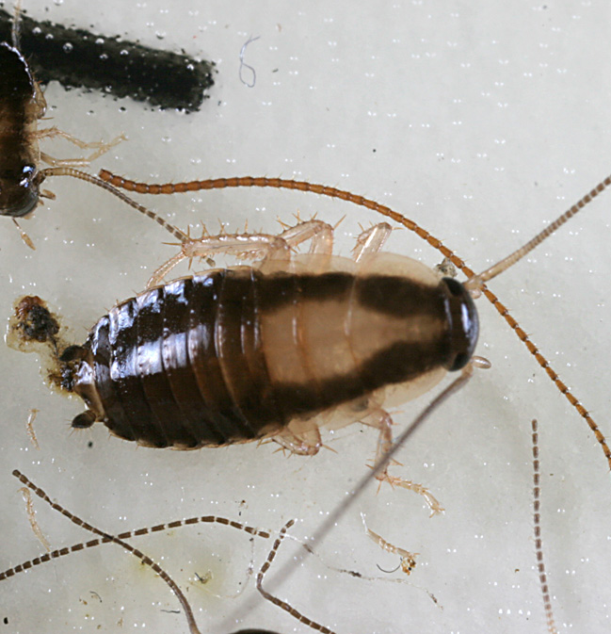
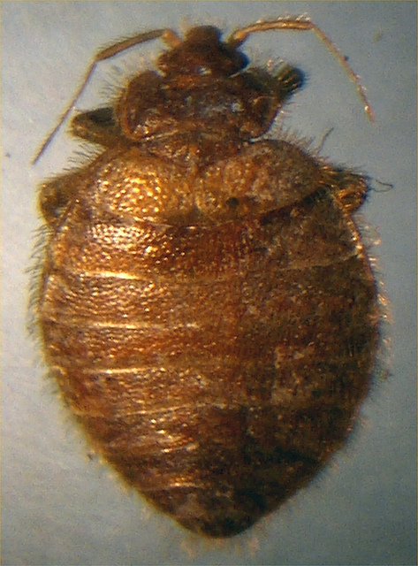
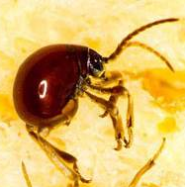
Pueden ser confundidos con…
Garrapatas
Ninfas de cucaracha
Picaduras de otros insectos
Reacciones alérgicas a químicos
Garrapata
Picadura de mosquito
Ninfa de cucaracha
Bat Bug (de murciélagos)
Escarabajo araña
Notes:
The photos are of a tick, mosquito bites, a cockroach nymph, a bat bug, and a spider beetle a few of the insects that have been found in the homes of people who thought they had bed bugs. Proper identification can save time, anxiety, and money. The only way to confirm bed bugs is to find live bed bugs, collect a few, and have a professional identify them.

Slide 10
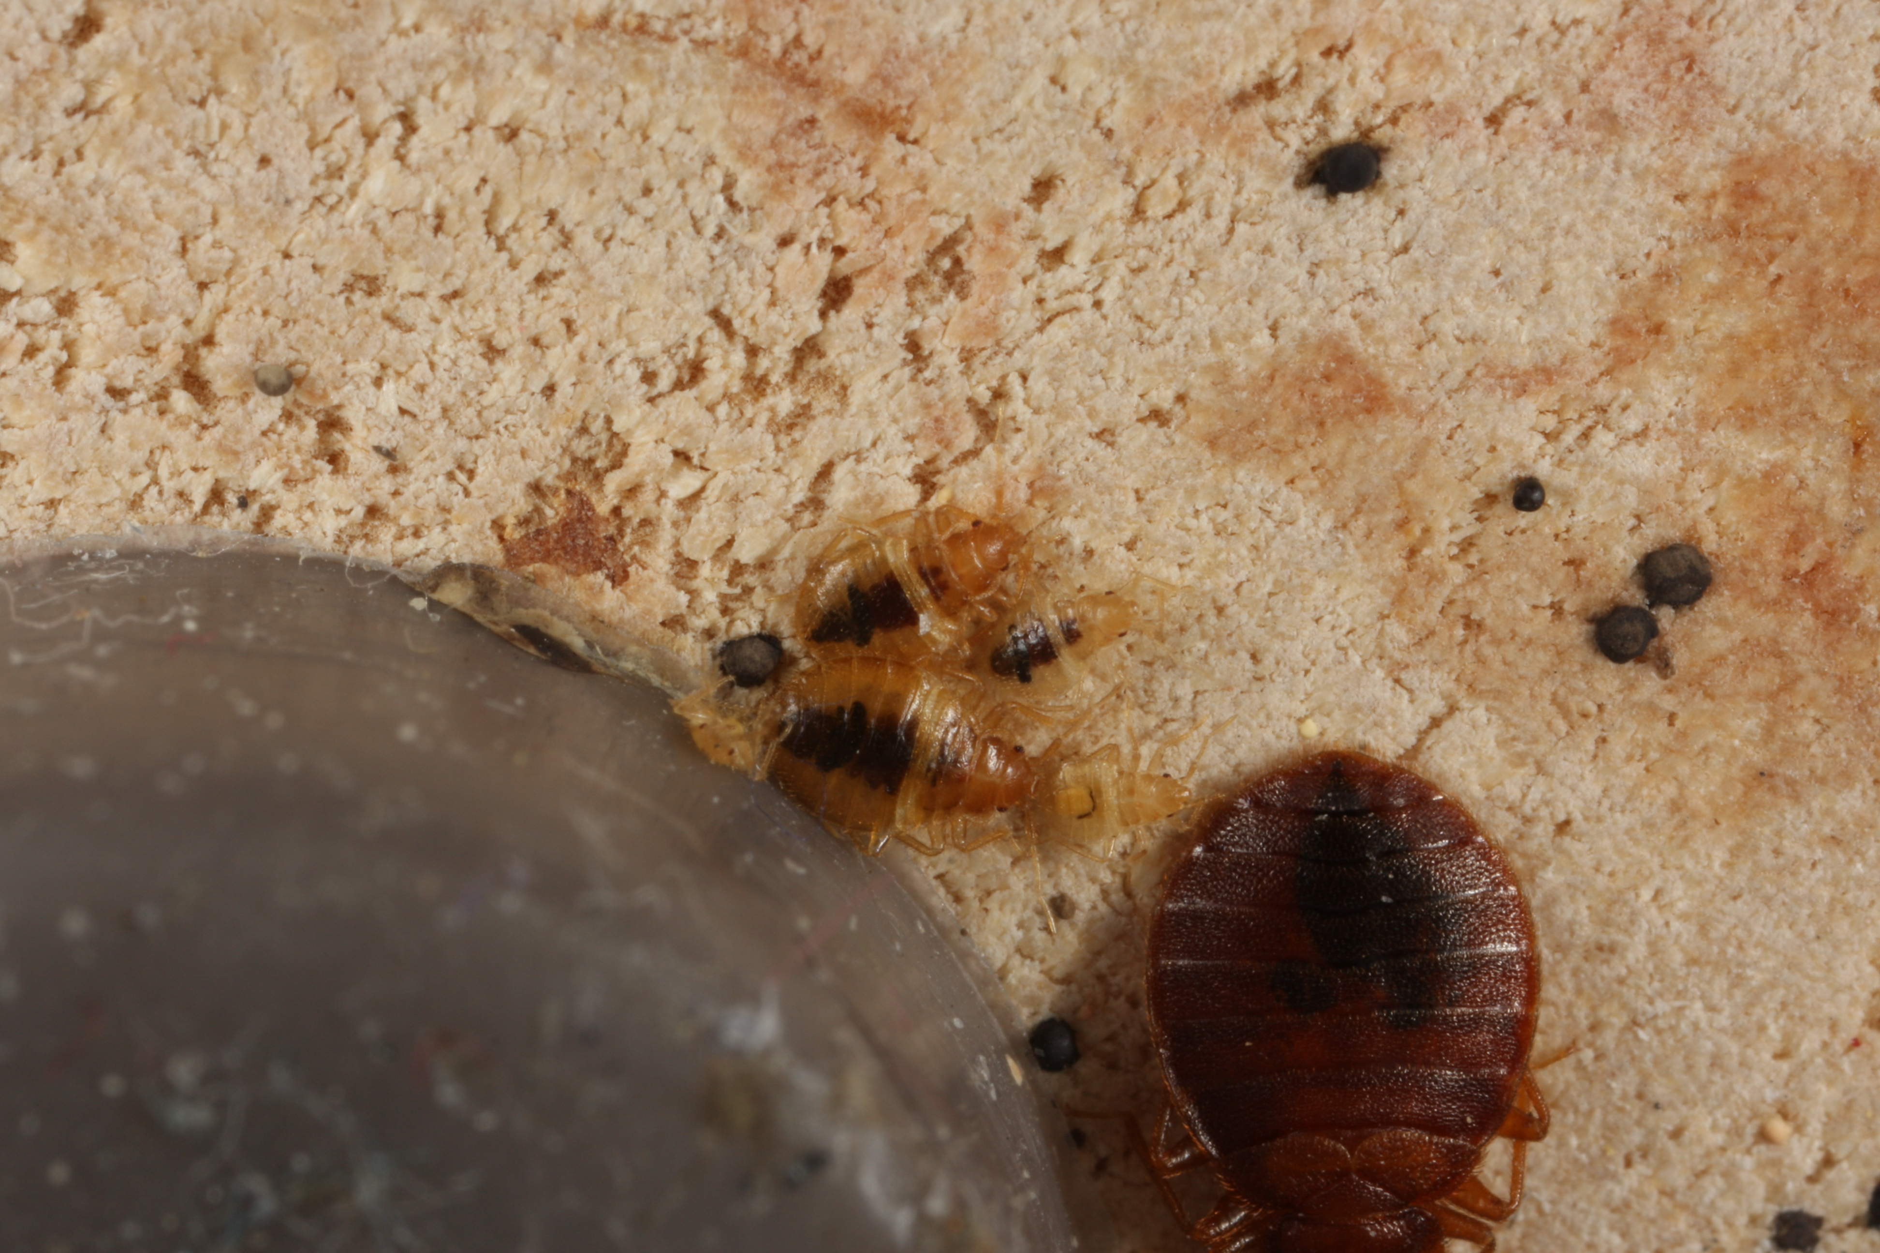
Signos de chinches de cama
Picaduras
Manchas fecales
Mudas de piel
Chinches muertos
Chinches vivos
Notes:
10
Bed bugs are small and very good at hiding, so a flashlight is needed to see them (or evidence of them).
Keep looking until either a live bed bug is found or all involved feel satisfied that there are no bed bugs.
If bed bugs are found, a few should be put on tape or in a re-sealable plastic bag for identification.
The photo shows bed bugs that were snuggled next to the screw-in foot of a recliner. It took flipping the recliner over to find them. When the foot was unscrewed, more were found.

Slide 11
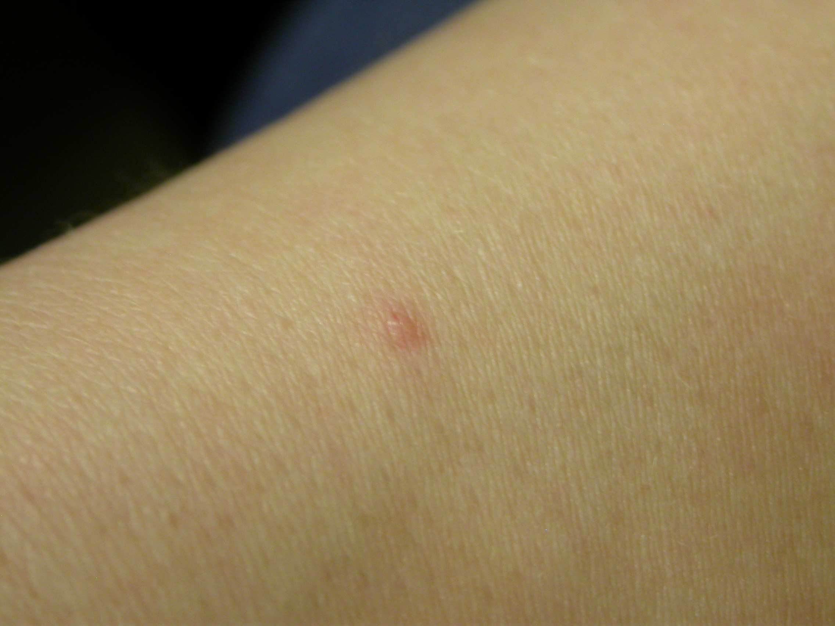
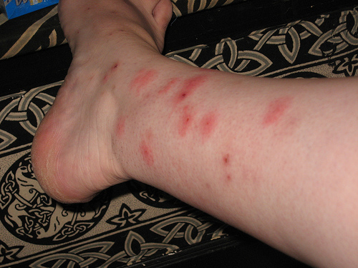
Picaduras
Chinches de cama no pueden ser confirmados por la picadura sola—las picaduras no se ven o tienen reacción en todas las personas
Se deben encontrar chinches de cama vivos
Notes:
There is a myth of bed bug bites always showing up in sets of three in a row: “breakfast, lunch, and dinner.” This is untrue. Bed bugs will come out of hiding to feed when they are hungry (usually once a week), feed until they are full, and then return to their hiding spots, leaving blood spots (bed bug poop) along their route. The bites in a row happen if there are any feeding along the sheet-human intersection or if one is disturbed mid-meal and has to reinsert its mouthpart.
Not everyone reacts to the bites, and a person’s reaction to bed bugs may change over time (not reacting at first, but then reacting after being bitten a number of times).

Slide 12
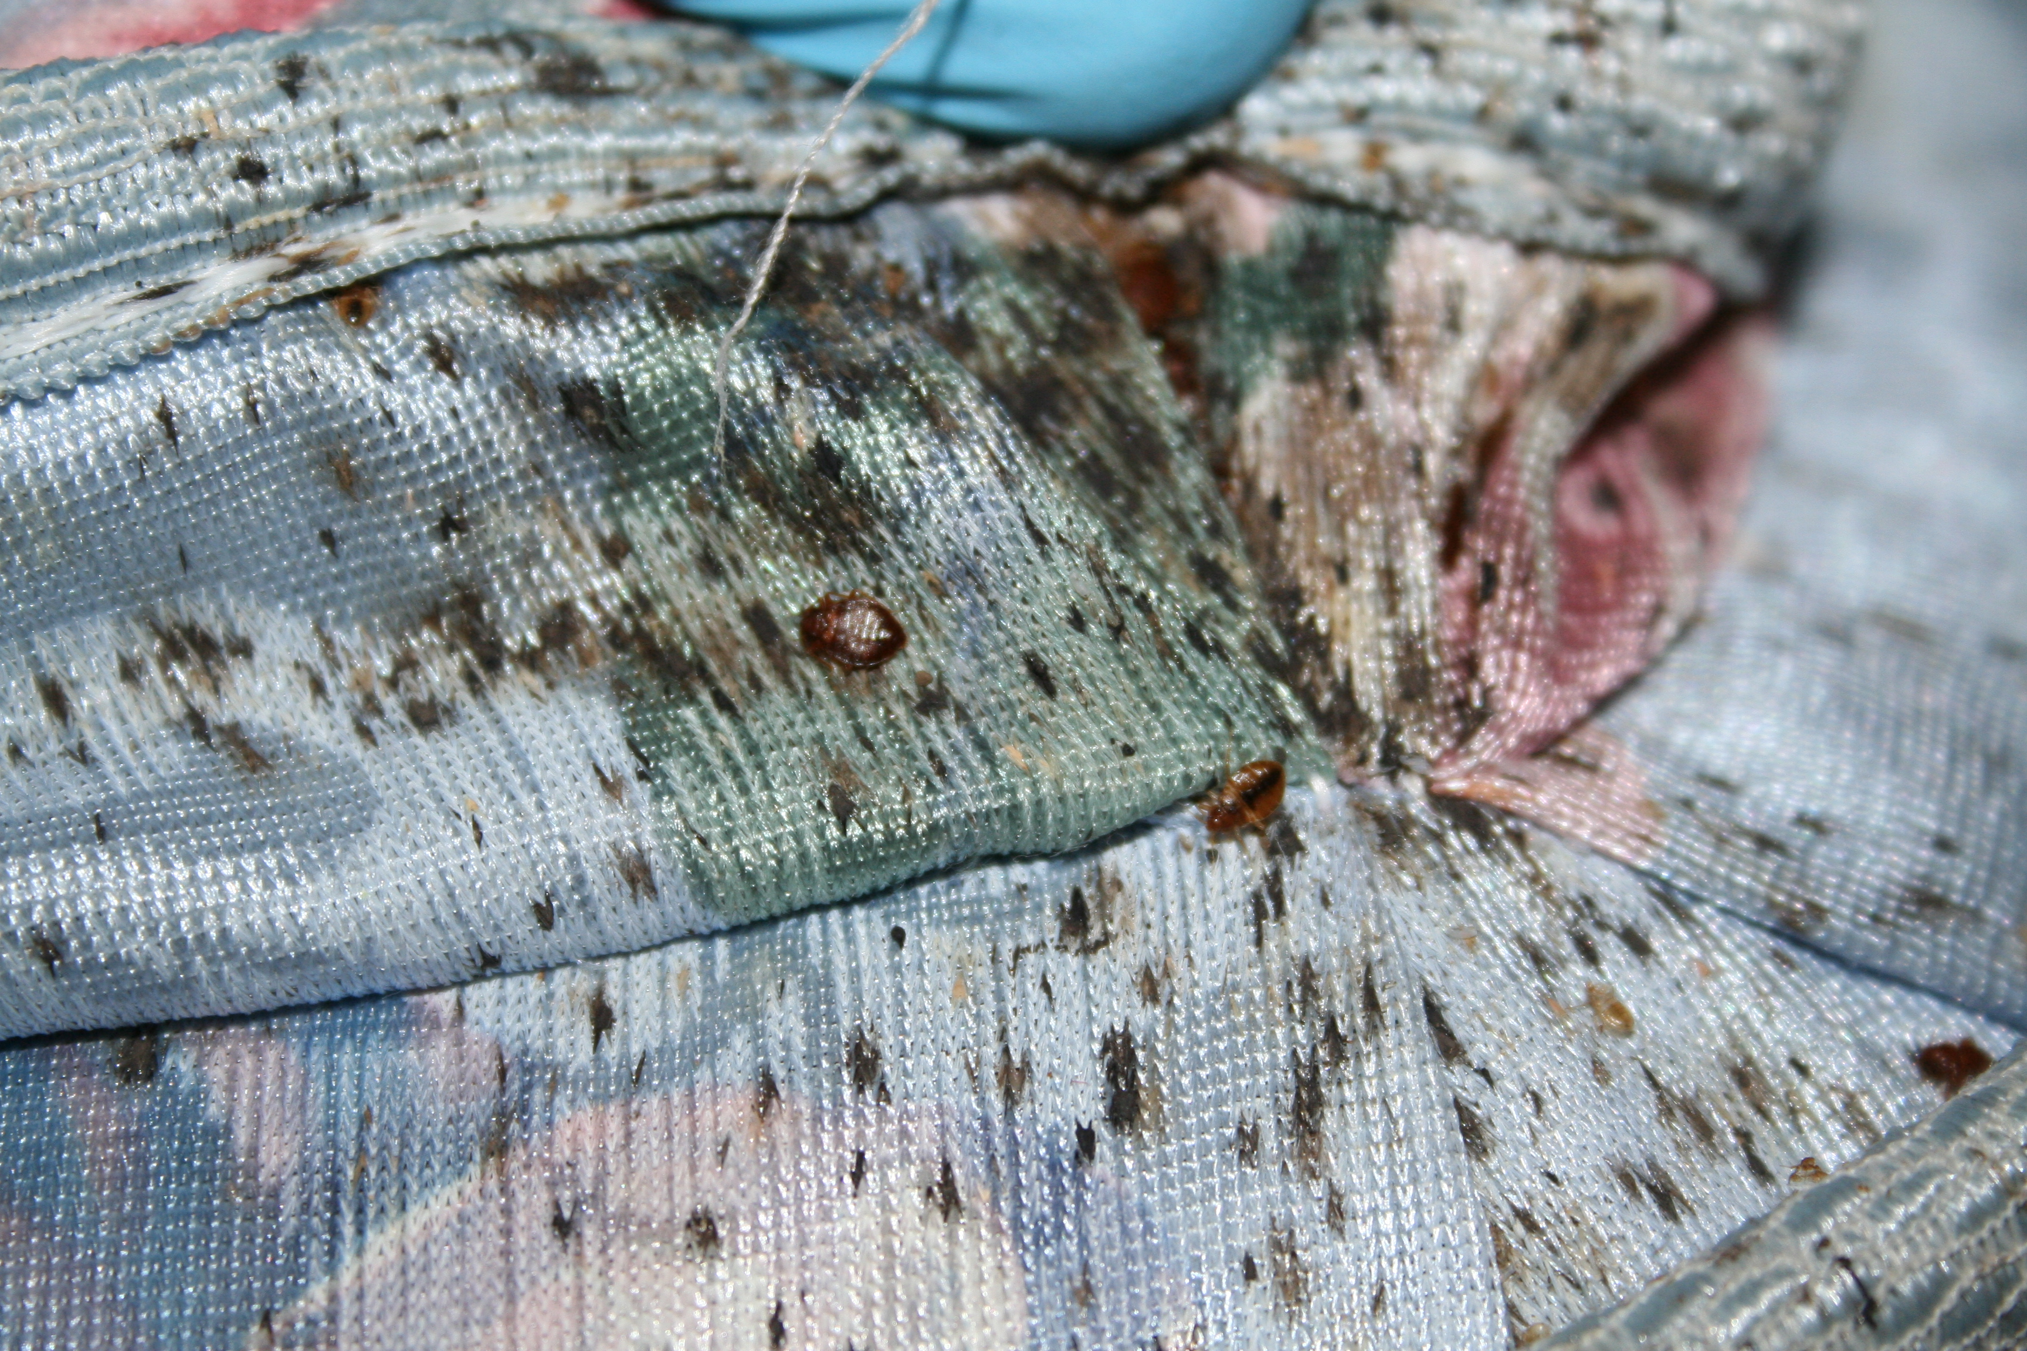
Manchas fecales
Manchas fecales son las heces (excremento) de los chinches
Son diferentes al excremento de cucaracha (frass), el cual es arenoso—las manchas fecales son lisas
Una infestación de chinches
de cama no puede
confirmarse por manchas
fecales solamente
Deben encontrarse
chinches de cama vivos
Una mala infestación
Notes:
Fecal spots are bed bug poop. Some people may have heard them called "blood spots." You may find blood spots on sheets where someone squished a recently fed bed bug, but fecal spots are small dark dots, like the dot a fine tipped sharpie would make. Fecal spots will be found on sheets, pillow cases, mattresses, and around the spot where they are returning to hide. Bed bugs often hide together (as evidenced in the picture above) but not always. Careful inspection with a flashlight must be done to find the spots where they are hiding…especially the loners. One pregnant female could restart an infestation.
You can distinguish fecal spots from cockroach frass. Frass is gritty, like pepper. Fecal spots are smooth.

Slide 13
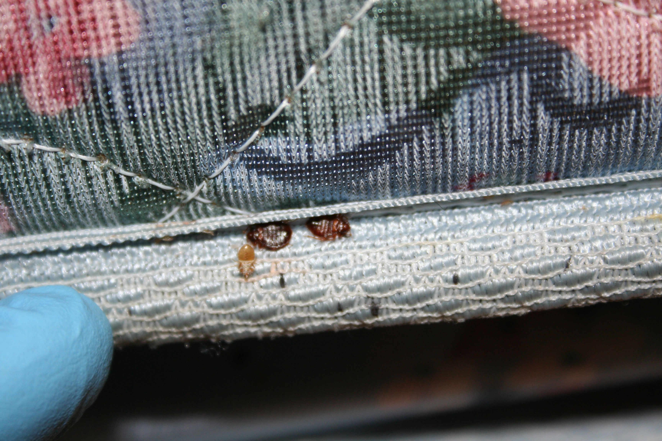
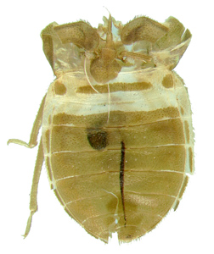
Mudas de piel
Signos de chinches de cama en una costura de colchón
Notes:
Bed bugs don’t have stretchy skin. When they need to grow up, they shed their outer layer—emerging as a larger version. They do this five times, going from the size of a poppy seed to the size of an apple seed. Shed skins look like hollow bed bugs and are the evidence of this growing process.

Slide 14
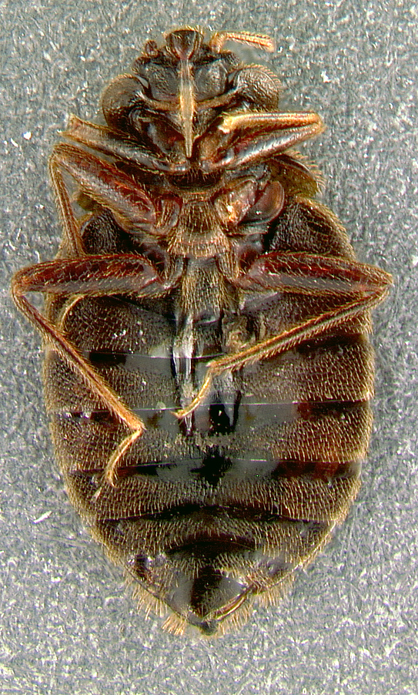
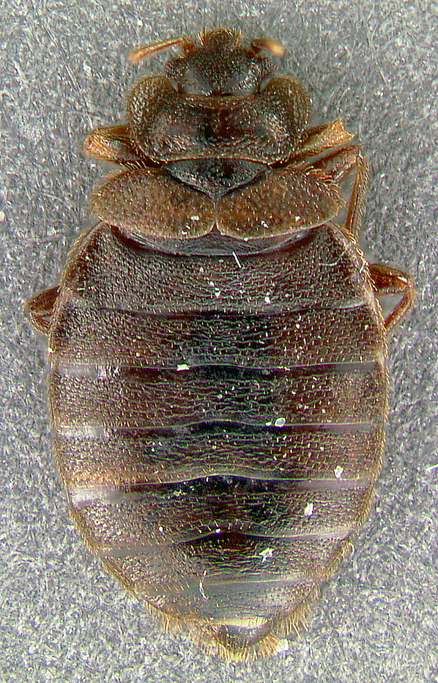
Chinches muertos
Parte inferior
Parte superior
Notes:
Bed bugs live for less than a year at room temperature. Dead bed bugs may be found in units that residents have tried to treat. This is particularly of concern if the bed bugs have been killed on the mattress. Many products are not labeled for use on mattresses. If you suspect the resident is putting pesticides on the mattress, someone should talk to the resident and make sure they are following label directions. We recommend vacuuming followed by steam, cryonite, or encasement for mattresses and box springs.

Slide 15
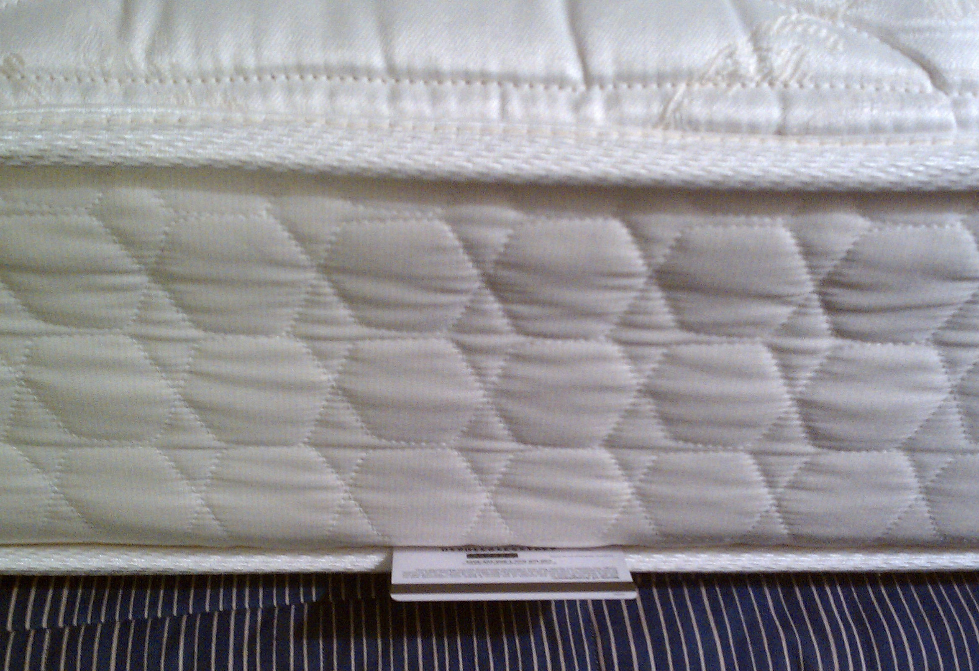
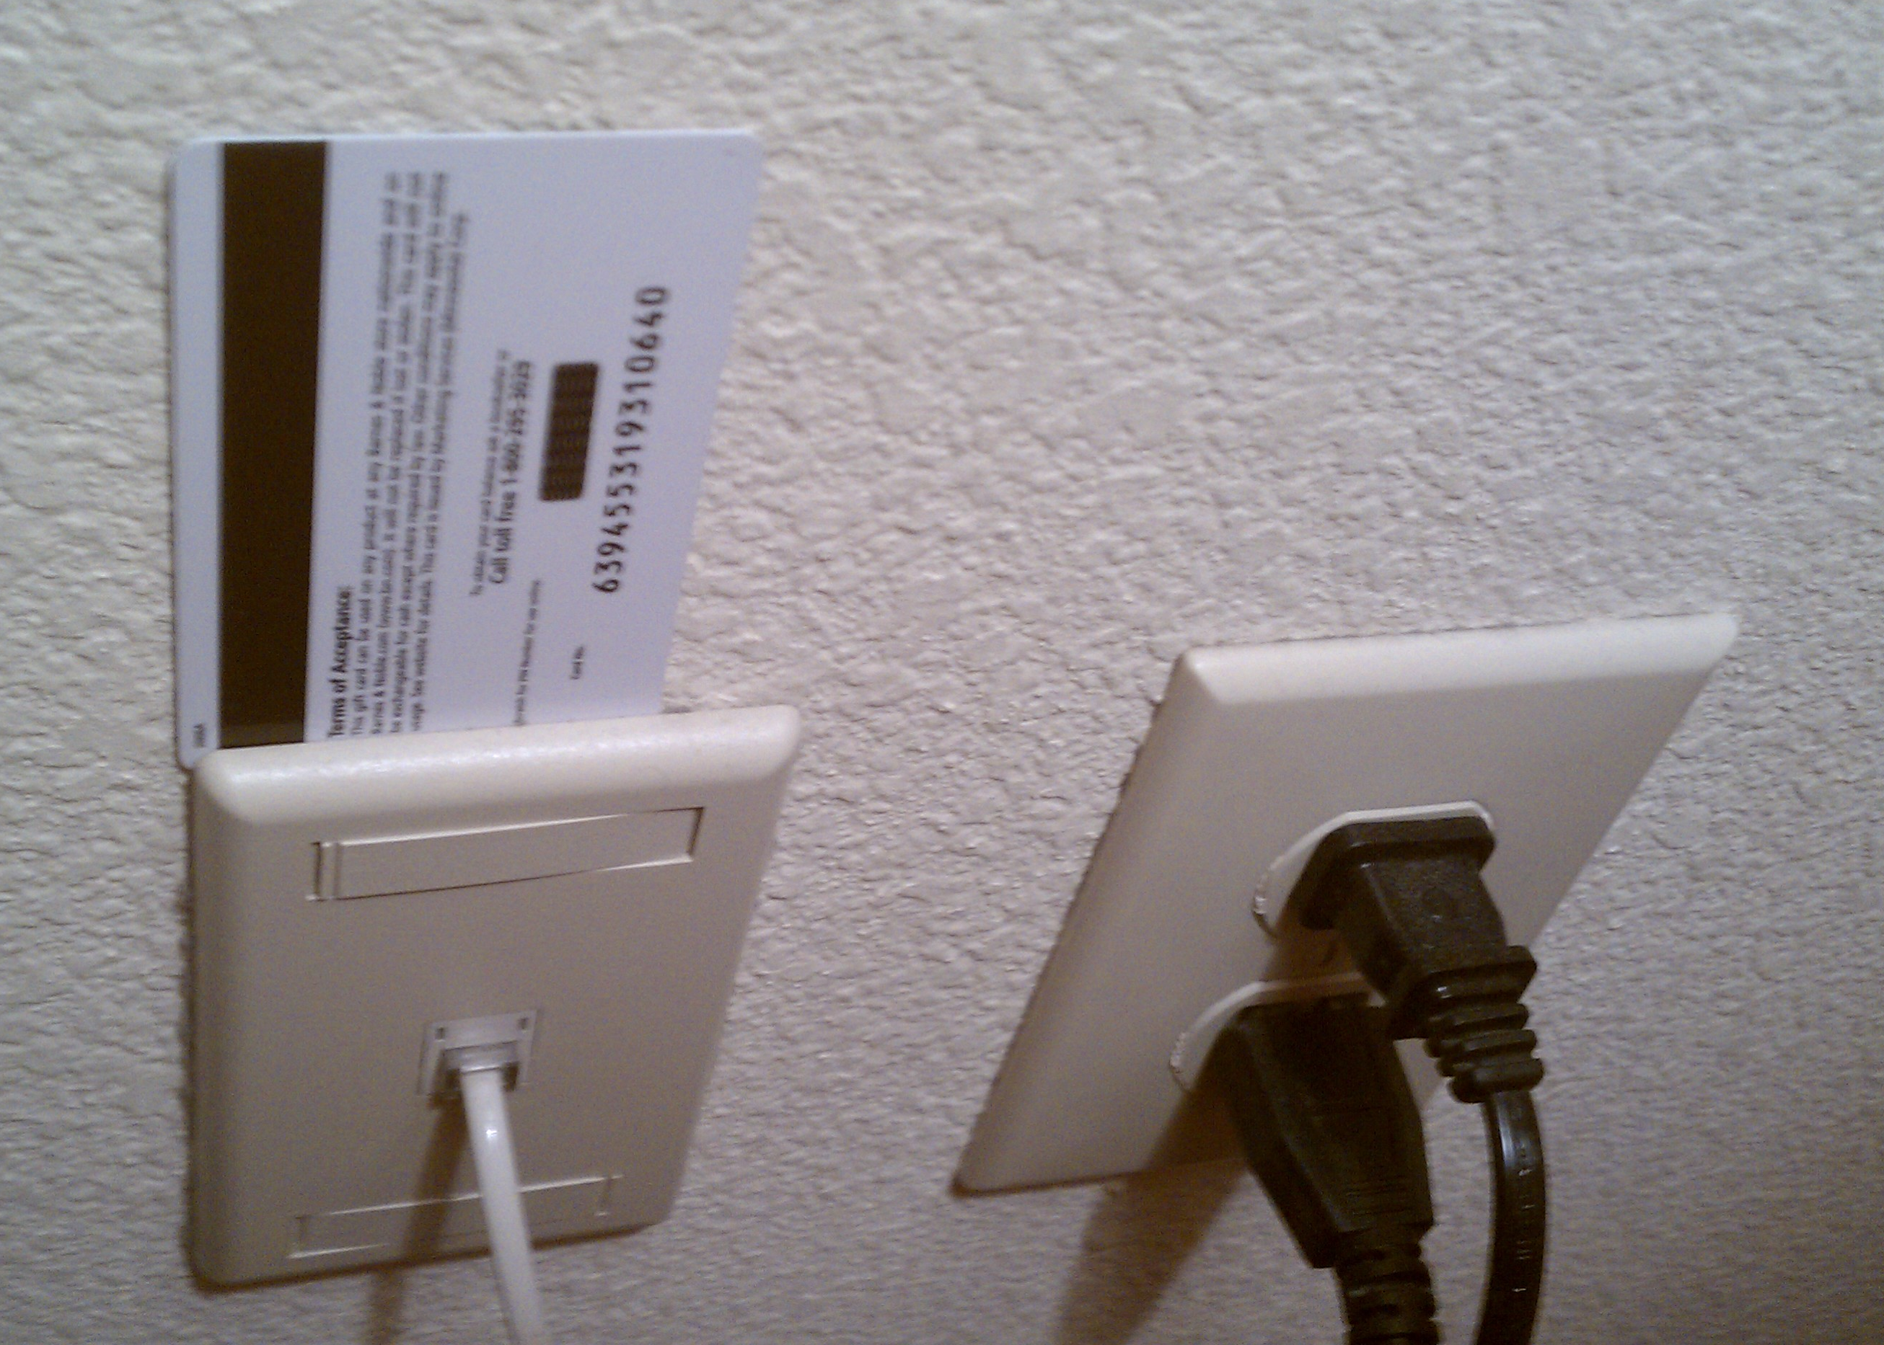
Donde viven las chinches de cama
En el edificio
En cualquier grieta o hendidura donde el borde de una tarjeta de crédito puede caber
En cualquier cosa cerca donde personas descansan
Tubería de colchón
Placas de interruptor
Notes:
Sanitation plays a role in bed bug control because a cluttered apartment will be nearly impossible to treat. Bed bugs can hide anywhere, and cleaning will unearth them. Vacuuming and washing bed linens often will help keep populations from growing.

Slide 16
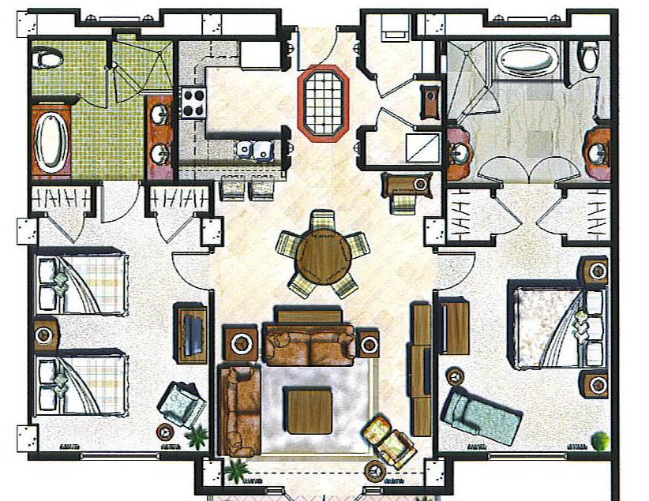
Donde viven las chinches de cama
Camas, sofás, mesas de noche, reclinables, marcos de cuadros…
= Puntos claves
Notes:
Bed bugs need blood to live, and blood is easiest to get when people are sleeping. So trainees need to look where people rest.
When bed bugs are suspected the locations in red should be inspected first.
The circles with dark red centers are the places within the unit where people are likely to rest: beds, sofas, and recliners. After feeding, bed bugs hide in nearby cracks. This increases the area one has to inspect to the lighter red ring. Note that the potential infestation area now contains tables, lamps, walls, and carpets. Encourage trainees to think in three dimensions: carpets, table drawers, hanging picture frames, peeling wallpaper, and box springs. The units above, below, and sharing walls with these infestation sites might have bed bugs.

Slide 17
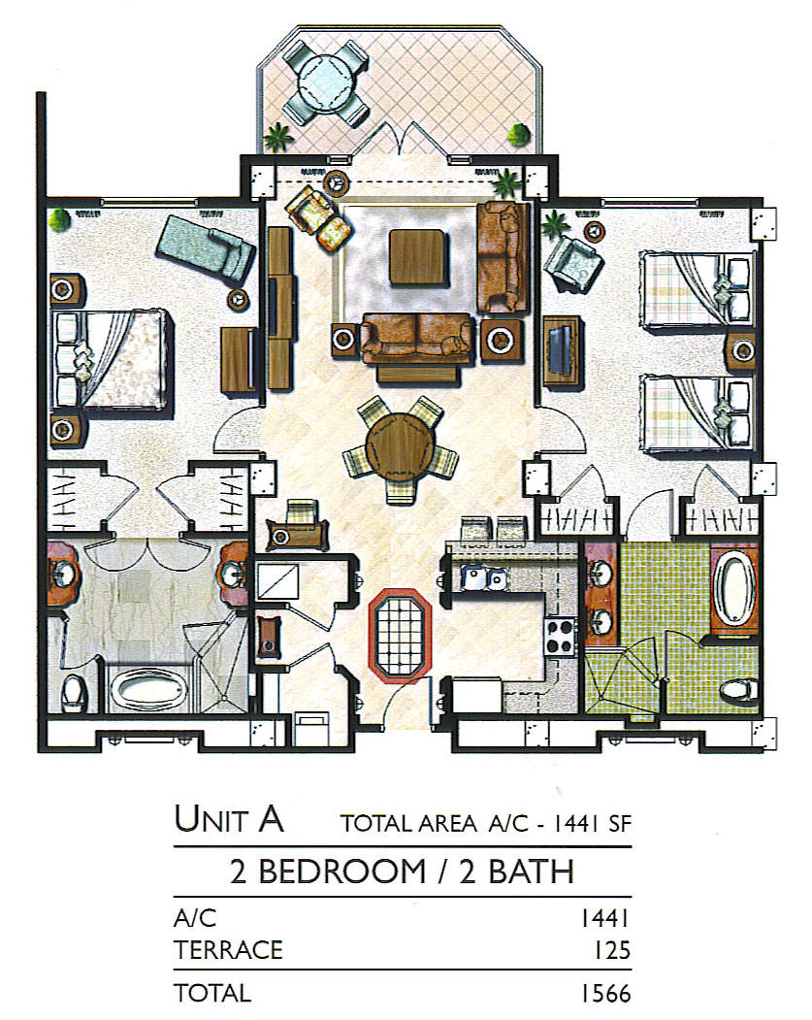
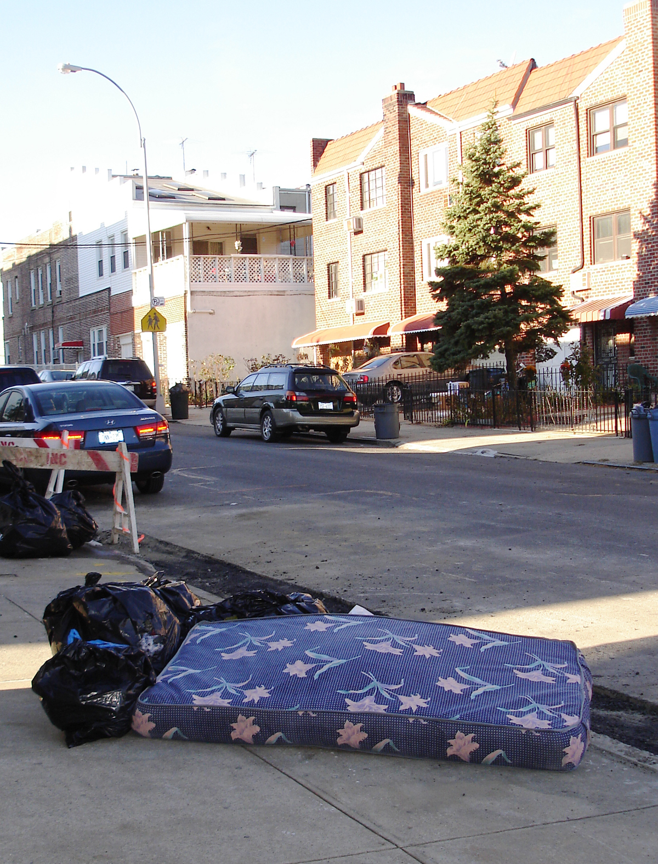
Cómo se propagan las chinches de cama?
Se arrastran activamente a lo largo de cables, tuberías, y debajo de puertas
Pasivamente en cualquier cosa que viene de una unidad infestada (muebles, mochilas, ropa...)
Qué hay al otro lado de la pared?
Notes:
17
Prevention is key.
Since bed bugs are so reliant on humans, they have become very good at staying close to them. In public housing, one infestation can quickly spread throughout the development. The spread usually occurs when:
-residents in adjacent units do not inspect regularly, Bed bugs will travel along pipes or on wires if their food source is removed, or if the infestation gets too crowded. If a unit has bed bugs, all adjacent units should be inspected.
-management does not have the PMP inspect and possibly treat adjacent units,
-infested items are moved through the building without being wrapped in plastic,
-infested items intended for the trash are picked up and brought home,
-staff visits multiple units per day with bags or equipment
-residents visit each other carrying backpacks,
-or bed bugs are brought to the laundry room on bedding and people bring them home from this location.
If infested items are to be brought to the trash: 1. Cover the infested item with plastic for transport through the building. 2. Once outside, make the item unusable by breaking or cutting it open. 3. Put the broken item inside a covered trash receptacle. All these steps help ensure that bed bugs are not spread into uninfested areas within the PHA.

Slide 18
Lugares a riesgo de introducción e infestación
Introducción es probable donde la gente
  Viajan frecuentemente
  Ponen cosas personales
  se sientan o acuestan por largos períodos de tiempo
La infestación es probable donde las chinches pueden
  Rastrear (muebles tapizados o ropa de cama)
  Alimentarse de una persona durante 5 minutos sin ser detectado
  Se esconden en grietas o pliegues
Notes:
Inspect and monitor in these areas to detect bed bug infestations early-on.
Have trainees list areas in the building that are at risk for introduction AND infestation.

Slide 19
Inspección
Siempre use una linterna
Si se encuentran insectos de la cama, inspeccione todas las unidades adyacentes
Dos tipos
  Visual
  Canino de detección de olor
Notes:
Inspections using a bed bug detection canine are especially useful in two scenarios. 1. When a person reports bed bugs but the PMP can’t find any with visual inspection. 2. When a PMP wants to confirm that the area is bed bug-free, for example post- treatment. Canine inspections for bed bugs may identify emerging infestations in their earliest stages, helping property managers gain building-wide control before an infestation spreads to other units, saving considerable time and money.
Inspection with canines is useful for detection, but as with inspection by humans, there is potential for error. You should be able to verify the presence of bed bugs where the dog "alerts" the majority of the time. The dog’s effectiveness depends upon the quality of its training, the ability and consistency of its trainer, and the conditions in the area of inspection. If trained and handled properly, bed bug-sniffing dogs can inspect much more effectively and in a much shorter time than a human. Contact the National Entomology Scent Detection Canine Association (NESDCA) for more information.

Slide 20
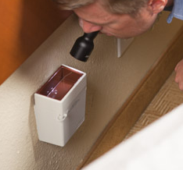
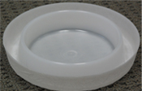
Monitoreo
Atrape y mate las chinches
Determine la gravedad de la infestación
Dos tipos
  Pasivo
  Activo
Photo credit: FMC Corp.
Activo, trampa de plug-in
Pasivo, interceptor de estilo-foso
Notes:
Monitors will not control a bed bug infestation, but they will trap and kill some. More importantly, they help find bed bugs or confirm their presence so that management can take further action. There are two types of monitors for bed bugs: passive monitors do not have an attractant and must be placed where the bugs will walk over them; active monitors have an attractant —a combination of heat, carbon dioxide, and an attractive chemical.
Reference: Rutgers University evaluation of monitoring devices: http://www.rci.rutgers.edu/~insects/bedbuginterceptor.pdf

Slide 21
¿Tienes chinches de cama? Ahora ¿qué?
Si los encuentras y controlas a principios de la infestación, la propagación de las chinches de cama se puede detener
La detección temprana y respuesta rápida son fundamentales para la gestión de chinches en todo el edificio
Solamente PMP aplican pesticidas
Notes:
21
From HUD's Notice PIH 2012-17: "The PHA should respond with urgency to any tenant report of bedbugs. Within 24 hours of the tenant report, the PHA should make contact with the tenant, provide the
tenant with information about control and prevention of bedbugs and discuss measures the tenant may be able to take in the unit before the inspection is performed. However, a bedbug inspection and, if necessary, treatment, may take time to schedule. The PHA should endeavor to take appropriate action within a reasonable time period using the guidelines provided below [in the Notice].

Slide 22
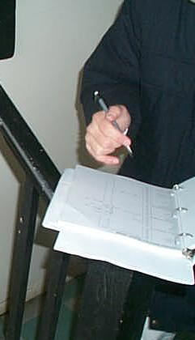
Si alguien encuentra un chinche de cama
Documente todas las observaciones:
Guarde el insecto
Reporte el problema
No aplique pesticidas o mueva las cosas
Evite llevar las chinches a otros lugares
Haga que el PMP inspeccione la unidad y las unidades adyacentes
Notes:
Refer back to previous discussions of the IPM log.
Collect a specimen on a piece of tape or in a jar with a splash of isopropyl (rubbing) alcohol in it.

Slide 23
Estimule una respuesta de la comunidad
Educa a todos
Destruye artículos desechados
La vivienda debe tomar la carga financiera y proveer a los residentes
  cubierta para el colchón
  monitores
  bolsas grandes para trasladar los muebles
Notes:
Mattresses and furniture with bed bugs do not have to be thrown away.
If mattresses are to be kept, use a fabric mattress encasement. Bed bugs can crawl out of tiny rips so the most important factor in using a mattress encasement is that it does not rip. Vinyl or plastic covers will not work. Encasements with bed-bug-proof zippers are ideal. The box spring can also be encased.
If no food is available within a few hundred feet or they are trapped, bed bugs will go dormant. They are thought to be able to live without feeding for many months. Because of this, it is critical that the mattress encasement stay on and intact (closed) for at least six months.
If appropriate, the mattress may be treated with pesticides available to a PMP. Pesticides should not be used on children’s furniture or around chemically sensitive people. Steam or cryonite are preferred for killing bed bugs on mattresses.
Movement of infested items throughout the development may spread bed bugs. If items are moved through the building, make sure they are covered in plastic and made unusable once they are outside (cutting open the mattress in multiple spots will work).

Slide 24
Prepárese en adelanto
Una vez que los chinches de cama están presentes, usted no quiere molestar la zona
Idealmente, los residentes rutinariamente
  inspeccionan con una linterna
  lavan la ropa de cama
  limpian con aspiradora
  mantiene su unidad de acuerdo con estándares de limpieza

Slide 25
Prevenga la introducción y propagación: residentes
Administre los artículos que entran o salen de la casa
  Mantenga abrigos, mochilas, carteras y bolsas fuera de las camas, sillones, y sofás en el hogar y mientras está afuera
  Inspeccione con cuidado los muebles usados antes de traerlos a la casa-evítelo si es posible
  Busque por signos cuando duerme en otros lugares
Notes:
Education throughout a development to help prevent bed bugs is worth the PHA‘s time.
Reference: Bed bug poster with a spot where contact info can be filled in.

Slide 26
Consejos para personal, auxiliares de salud, y contratistas
En las unidades:
  Evite sentarse o colocar objetos en superficies potencialmente infestadas
  Use una capa protectora cuando mueva los artículos infestados
En las áreas principales de la oficina / comunidad:
  Reemplace los muebles de tela que tienen muchas grietas con plástico o artículos de metal
  Durante las reuniones, requiera que los residentes pongan sus pertenencias en bolsas de plástico
Notes:
Explain to residents that these precautions (protective layers, plastic totes, etc.) are used community-wide to prevent spreading bed bugs between residents. They are never targeted at an individual resident. It is particularly important to have this conversation when working in a resident's home while wearing protective layers—you don't want the resident to think that you think they are unclean. Bed bugs are not associated with poor sanitation.
If you suspect you have bed bugs on your clothes, change to a clean pair and put the bed bug clothes in a hot dryer for 30 minutes.

Slide 27
¿Quién es responsable?
El PMP da todas las instrucciones después de la inspección
Asigna responsabilidades de preparación realistas, teniendo en cuenta las limitaciones financieras, físicas, y limitaciones mentales de las personas involucradas
Las instrucciones se realizan idealmente por la persona que es propietaria de los materiales
Si no son capaces
Familiares y amigos
Personal del edificio
Ayudantes
Grupos sin fines de lucro
Empresas contratadas
Si no están dispuestos
Recurra al contrato de arrendamiento, descripción del trabajo o cualquier otro contrato formal existente
Notes:
The purpose of trash management to control bed bugs is to limit the chances that discarded, infested items will be brought back into the building. A team effort is necessary to control bed bugs.
It is not the job of the housekeeping or maintenance staff to clean all the units, but if support service staff know of residents who cannot inspect (poor eyesight, weak, or disabled), they should find a way to help the resident clean and inspect.
Suggestion: Make sure the question of who is going to take apart and reassemble furniture is answered.

Slide 28
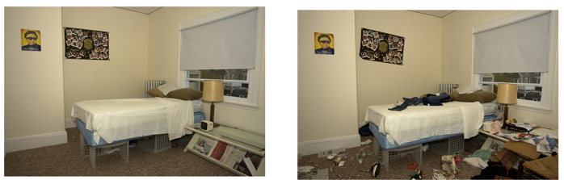
Escala de calificación de desorden
Acaparamiento compulsivo y la adquisición del cuaderno de ejercicios
Si se requiere preparación, comunique las expectativas a los residentes utilizando una escala de valoración visual
Notes:
So that you can make sure the residents are prepared for treatment, ask your PMP about their preparation instructions and how tolerant they are of clutter. Use the Clutter Image Rating Scale as a reference.

Slide 29
Opciones de tratamiento
Pasar la aspiradora
Aislamiento
  Encerramiento
  Bolsas transparentes
  Recipientes de plástico cerrados
  Hacer la cama una isla
Congelación
  CO₂ líquido
  Congelador de Arcón
Calor
  Secadora de ropa
  Vapor
  Envase
  La unidad entera
Los pesticidas
  Pulverización
  Polvo
  Fumigación
Notes:
Since bed bugs feed only on blood, control is different.
Although there are many things that a homeowner or resident can do to help treat bed bugs, this training encourages getting a PMP involved ASAP rather than taking time to treat the problem without one. Each pest management company should have instructions for residents on how to prepare the unit for a treatment.
Vacuuming
Every bed bug treatment will likely involve some vacuuming—even if it’s just the floors to make the PMP’s job easier. Vacuums are useful in medium and high infestations for getting rid of a lot of bed bugs relatively quickly without using pesticides. The same goes for cockroaches. We recommend using a bag vacuum with a HEPA filter and having a spatula or other tool available for dislodging bed bugs as you vacuum. As soon as you’re done using the vacuum, take the bag out seal it in a plastic bag, and throw it out. If all you have is a canister vacuum, you can use that too. After every use empty the canister into a bag, tie it off, throw it away, and wash out the canister. Either way, if you have to shut off the vacuum mid-job, plug up the hose with a paper towel. This will prevent bed bugs from crawling back out the hose and will wipe the inside of the hose when you turn the vacuum back on. If a vacuum will be used in many different areas, inspect it to make sure you don’t carry any hitchhikers.
If you don't want to deal with changing the bag, get one knee-high pantyhose and stuff the toe down the vacuum hose at the sucking end. Keep pushing it down the hose until about 8 inches are sticking out. Fold the open end of the pantyhose over the vacuum nozzle (like you fold a trash bag over the edge of a trash can) and secure it with a rubber band. Put the crevice tool on the vacuum hose over the pantyhose. The bugs will get trapped in the pantyhose and when you are done you can remove the rubber band, tie off the pantyhose, and pull it out for disposal.
Isolation
Encasements are discussed on the next slide.
Bed bugs can’t claw or chew through plastic. They’re also not great at climbing up smooth metal, plastic, or glass. Adding a light dusting of baby powder to the sides of a container makes it nearly impossible for them to climb up and out. You can take advantage of this in your management plan by using plastic totes, sealed bags, and encasements. Pulling the bed frame away from the wall and any surrounding furniture and putting insect interceptors under bed frame legs also isolates the bed.
Freezing
Two types of equipment will freeze bed bugs. Freezers that reach 0°F or colder can work for bed bugs. Although research is ongoing, it seems an object must reach 0°F for 3 days to kill all life stages of bed bugs. If it’s not that cold, it will take longer. Household freezer temperatures vary too much to depend on.
PMPs may offer a freezing treatment that uses dry ice. The equipment is designed to spray the dry ice snow over objects—flash freezing the bed bugs and their eggs. Only a professional should use this method. This system isn’t used exclusively, it’s usually a good option for sensitive objects like fine art.
Heat
Bed bugs and their eggs die when exposed to anything that is 120°F for about 30 minutes. Some companies have equipment—including heaters, fans, monitors, and computer programs for tracking temperatures—to heat up an entire area. Not every large area can be brought to a high enough temperature for a long enough time. The key to any heat treatment is to get every inch of every object at least 120°F. Paper, clothes, and carpet are all insulators that may block the heat. The PMP will have to move objects around and use fans to get the heat everywhere. Bed bugs that hide behind switch plates or baseboards may crawl into the wall void and escape. To get those bugs, the PMP will treat the voids with a pesticide dust. You will have to prepare for a heat treatment because some common items can’t take the heat.
Heat treatments are also available on a smaller scale. The same target temperatures and concerns apply. For luggage and other small items there are portable heat chamber options that anyone can purchase and use. Larger objects can be isolated in a chamber and heated up.
The hot setting on a dryer is one of the best options for bed bug management programs because of accessibility and ease of use. Dry fabric will be de-infested after 30 minutes on the hottest setting in a dryer. Even dry-clean-only items can go in a dryer—it’s water that these fabrics can’t stand. If the fabric is wet, run the dryer for the full cycle.
Steam is another heat option. You can use a commercial-grade steamer to kill bed bugs and their eggs. The target temperature is still at least 120°F, but steamers get much hotter than that—around 200°F. That’s hot. Be careful when using steam, both heat and water can damage objects and steam will conduct electricity. To ensure the killing temperature gets into every crack and crevice, move the nozzle head very slowly. To keep moisture down and reduce the likelihood of blowing bed bugs away without killing then, cover the nozzle head with a towel.
Pesticides that are legal for use against bed bugs will list bed bugs on the label. Most are sprays or dusts. EPA’s bed bug website has a bed bug pesticide search tool. The label is the law—follow it closely. Even botanical products and other least toxic pesticides pose risks. If you have pesticide questions, call or visit the National Pesticide Information Center. Many pesticide products don’t keep killing once they’re dry (no residual). You may have to do some preparation in the area so that the PMP can access all areas for treatment.
For an in-depth discussion see What's Working for Bed Bug Control in Multifamily Housing at http://www.nchh.org/Portals/0/Contents/bedbug_report.pdf
Suggestion: if the PHA’s PMP is present at the training, ask him or her what residents are instructed to do and have a discussion about who would help do this preparation for an elderly or disabled resident.

Slide 30
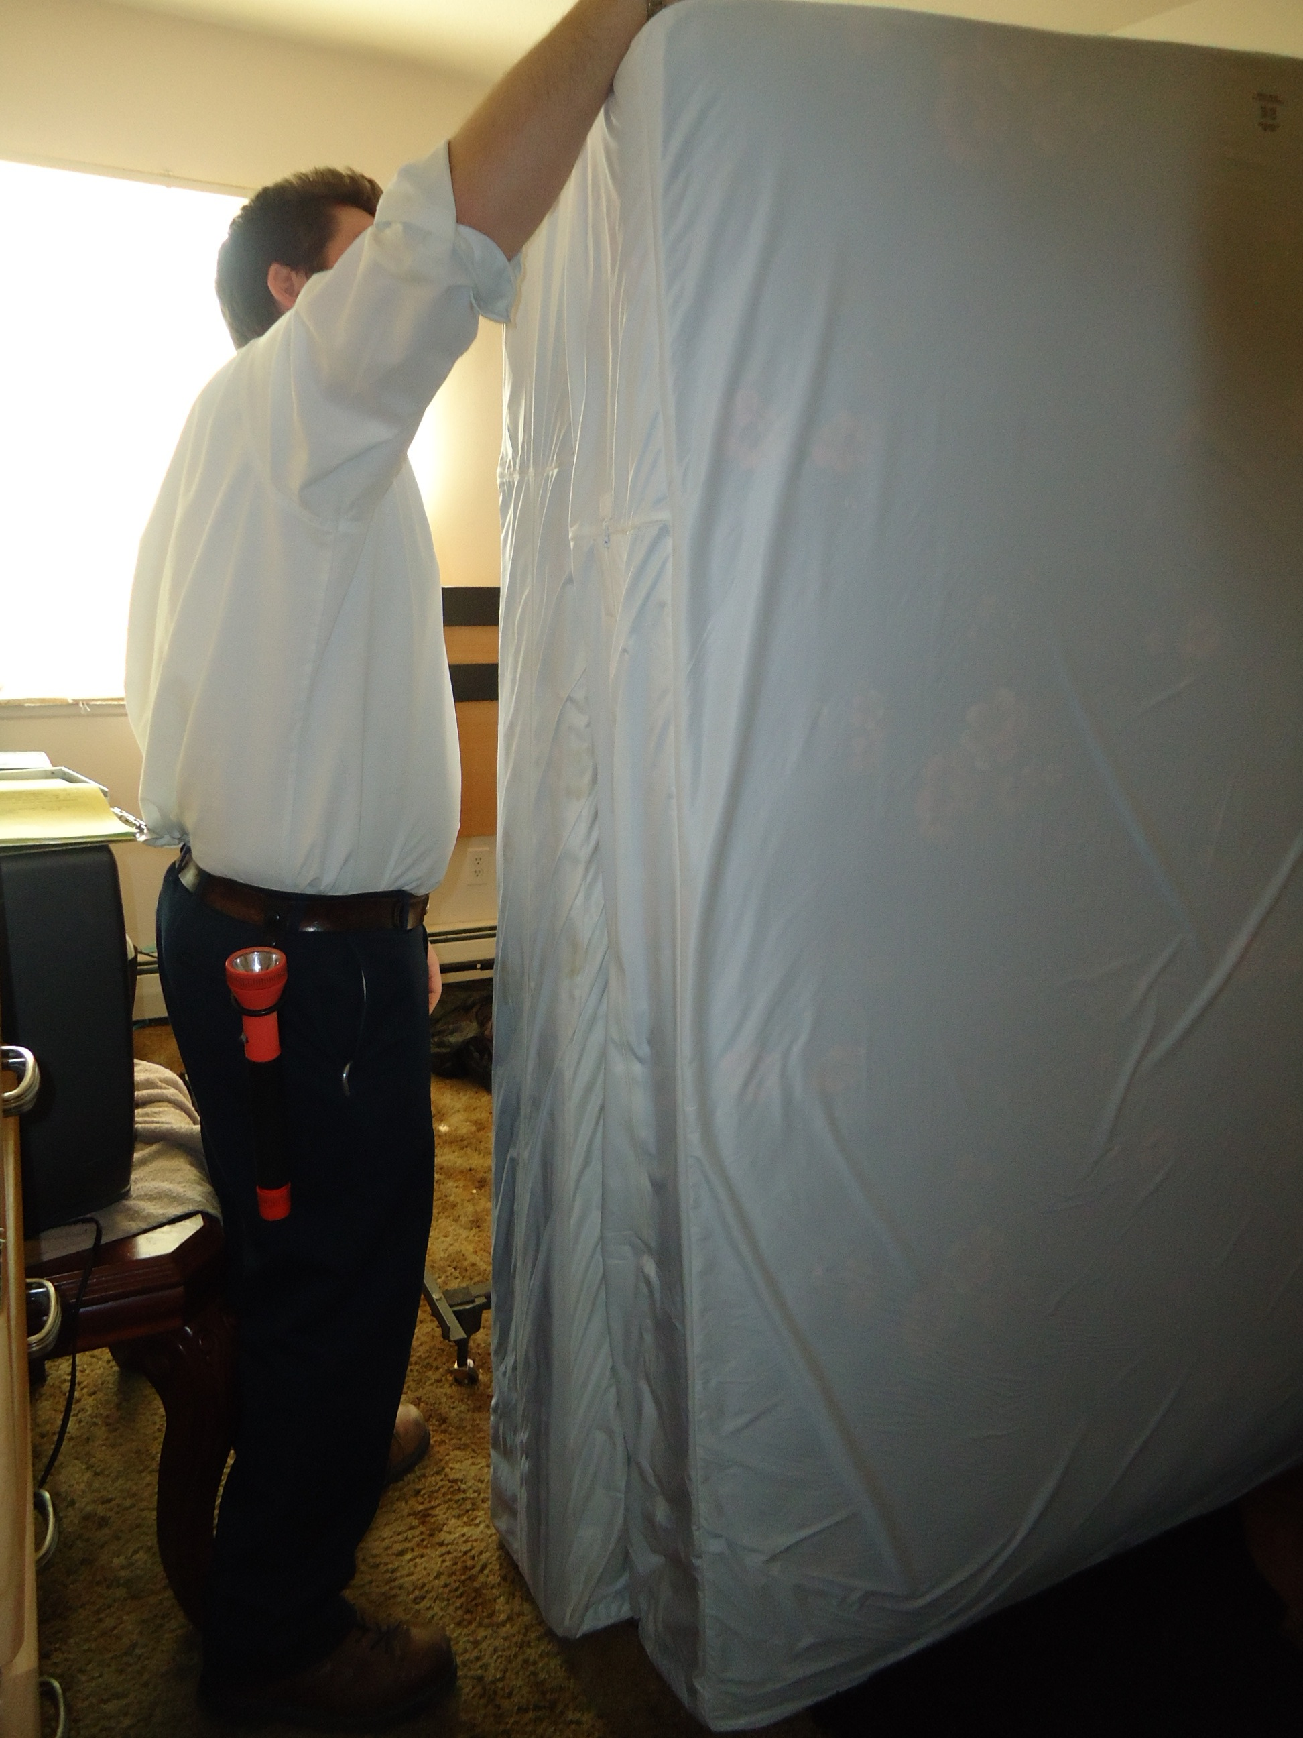
Utilice un protector de colchón
Cubra los colchones y somieres
Garantice un ajuste perfecto, cierre la cremallera, selle, y verifique si hay rasgaduras
Déjalo puesto
Cubra los puntos afilados en el marco de la cama con cinta adhesiva o fieltro
¡Colchones y muebles no tienen que ser desechados!
Notes:
30
Use fabric encasements designed for bed bugs. The encasement drastically simplifies inspection, making early detection easier especially on the box spring which has lots of spots where bed bugs can hide. The most common site of escape is through the zipper and bed bug encasements have special zippers. Most bed bugs will die within 5 months, but leave the encasement on and sealed just in case.

Slide 31
Función del PMP
SIEMPRE inspecciona a fondo la unidad reportada y las zonas adyacentes
Proporciona una preparación específica del lugar y las instrucciones de seguimiento en varios idiomas
Sigue la etiqueta
Vuelve a inspeccionar y a tratar si se encuentran chinches de cama

Slide 32
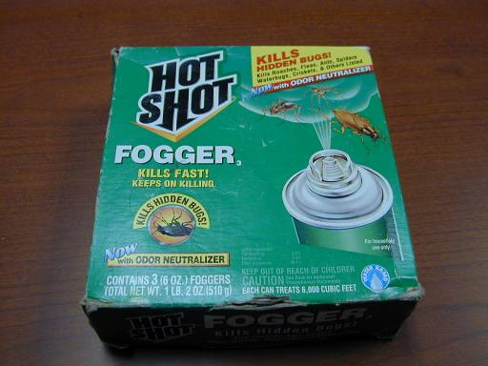
Sólo PMPs utilizan aerosoles
Los aerosoles no son eficaces cuando son utilizados por los propietarios de viviendas para el control de chinches
Over-the-counter-aerosoles y nebulizadores causan que los insectos se dispersen por lo que el problema se hace más difícil de tratar
Notes:
32
Sprays should not have to be used by the PMP for cockroaches and rodents, but since there are few other options for bed bug management, sprays may need to be used.
“Do It Yourself” sprays may be repellent, causing bed bugs to move away from the treated area. Their use can spread the problem, making the bed bugs harder to deal with and MORE expensive for a professional to treat (because of a larger treatment area). PMPs have the expertise and products to treat bed bugs. Residents should focus their efforts on nonchemical control practices.
A 2013 study by Dr. Susan Jones at Ohio State University showed that total release foggers do not work for bed bugs.
Sprays should not be used in the units occupied by people with chemical sensitivities, or in adjacent or neighboring units, common areas (such as the halls, lobby, laundry room, elevator, or stairs), or along paths of travel. Infants and children, the elderly, and pregnant women are at greater risk for adverse health effects associated with exposure to pesticides and thus it makes sense to use reduced risk practices, follow label instructions, and practice prevention-based approaches that reduce reliance on chemical control measures.
Reference: Jones, S. and Bryant, J. 2012 "Ineffectiveness of Over-the-Counter Total-Release Foggers Against the Bed Bug (Heteroptera: Cimicidae)." Journal of Economic Entomology, 105(3):957.

Slide 33
Una revisión de lo que debe hacer
Educar a todos acerca de lo que pueden hacer para evitar las chinches
Preparar anticipadamente antes de que chinches son reportados al minimizar el desorden y la instalación de encerramientos y monitores
Responder rápidamente con un profesional antes de que la infestación crezca y se extienda
Notes:
33

Slide 34
Questions?
Notes:
34

